Slide 1
Chapter 4: Getting Watson to talk back
Learning Bluemix & Cognitive
Bob Dill, IBM Distinguished Engineer, CTO Global Technical Sales

Slide 2
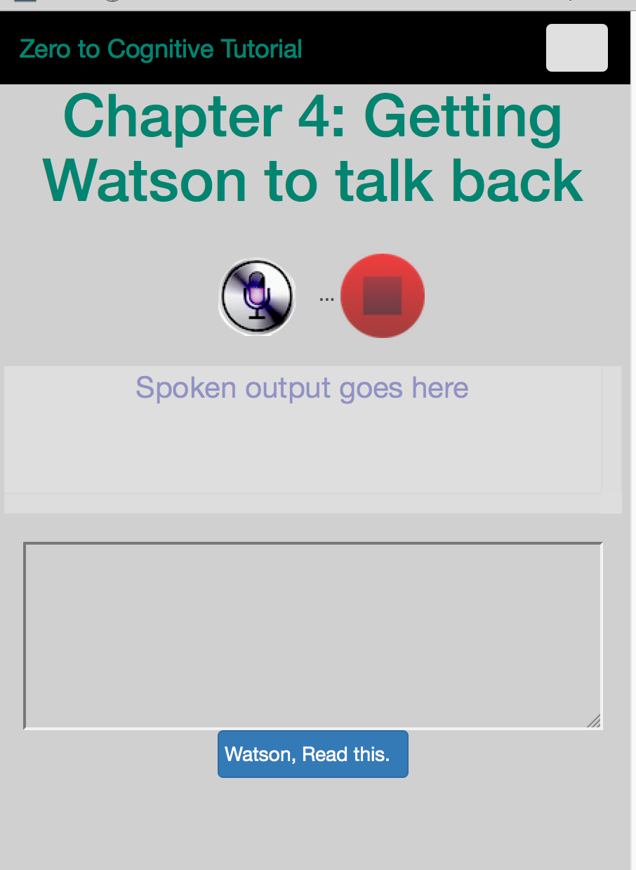
Chapter 4: Getting Watson to talk back to you
Get the Watson Text to Speech Service
Accessing your Watson credentials
Telling Watson what to say
The interaction flow

Slide 3

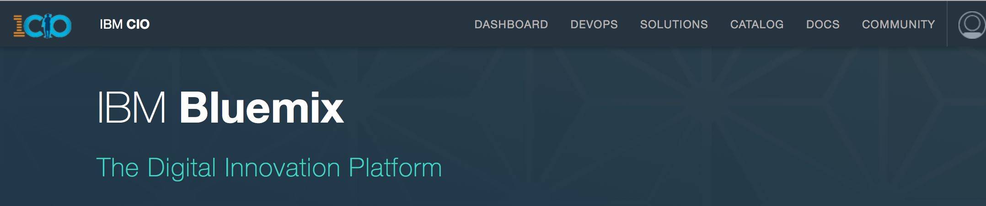
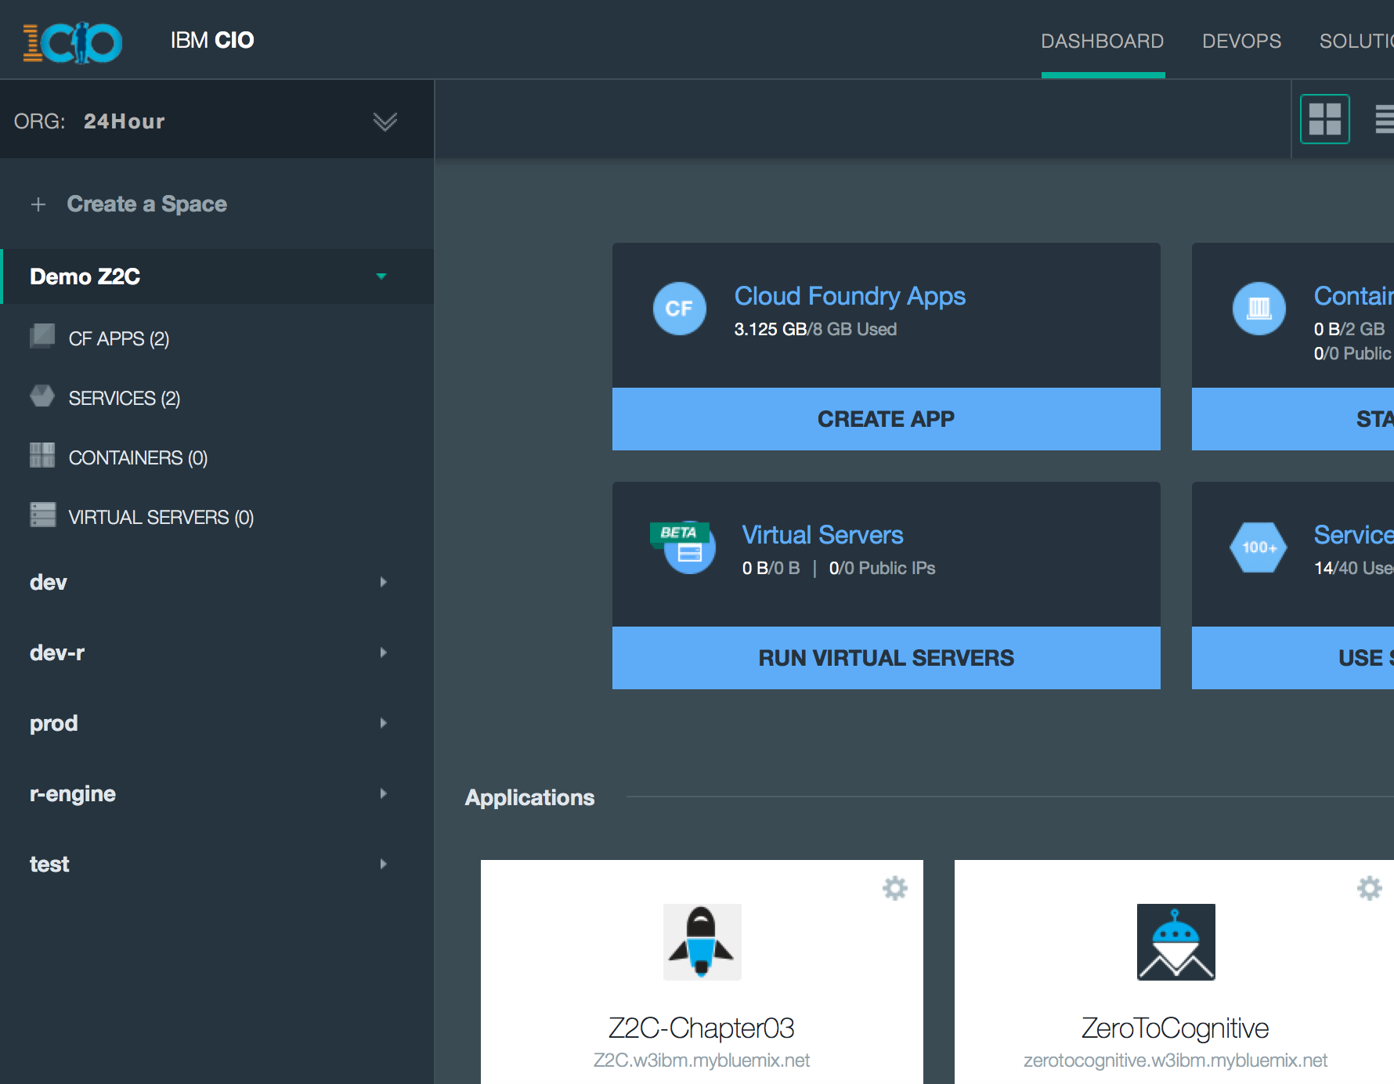
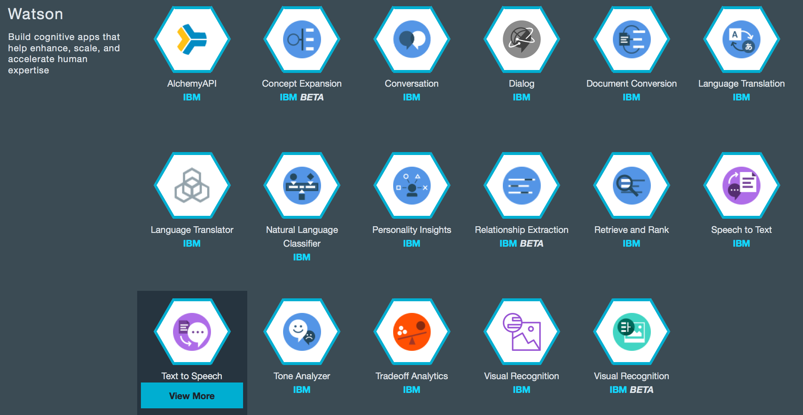
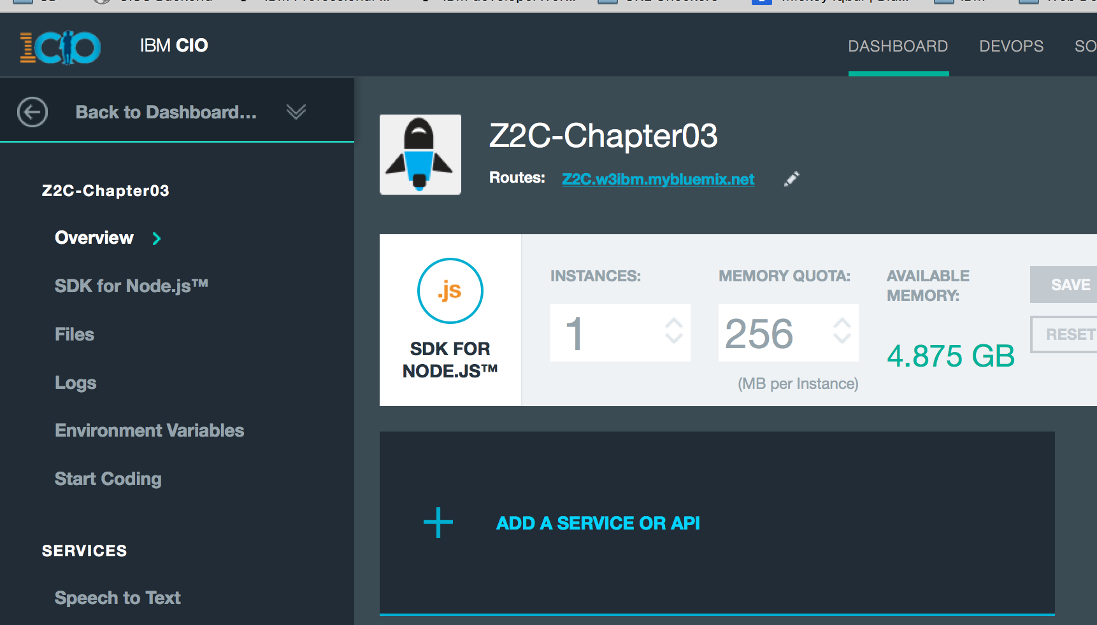
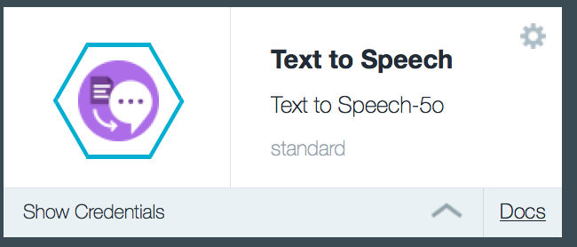


Watson Speech to Text
Add the service:
Go to your Bluemix dashboard and to your app.
Add a service or API
Select Watson Text to Speech
Get your credentials

Slide 4
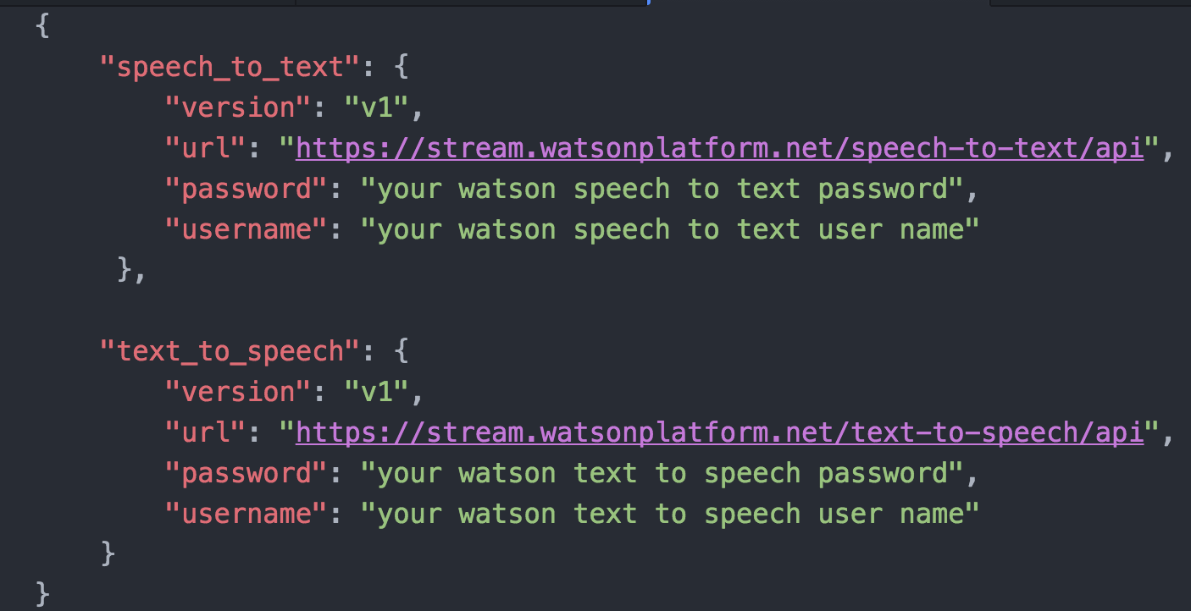

Update your env.json file
add a second JSON object to the file and insert your text to speech credentials.

Slide 5
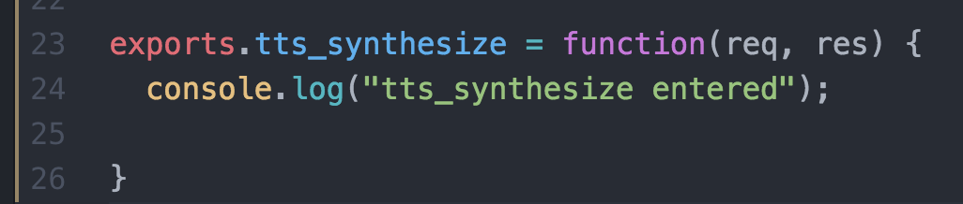
Add a new function to the controller speech_to_text file

Slide 6
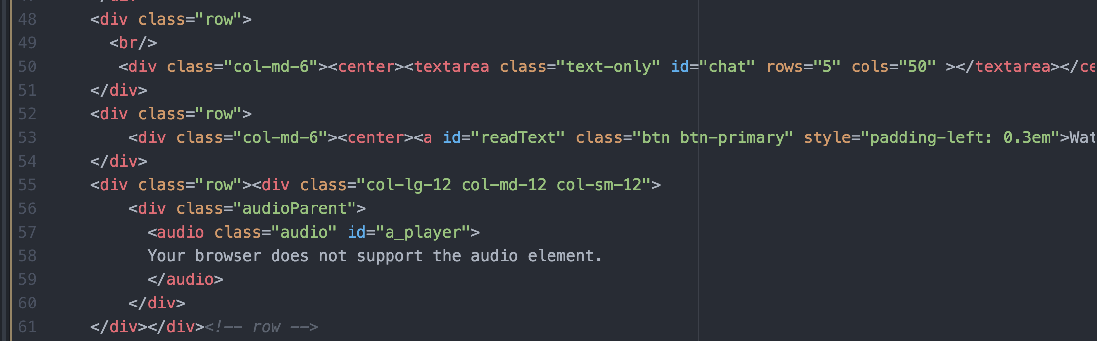
update index.html
Add rows to support a input text area, a ‘read this text’ button, and a player.

Slide 7
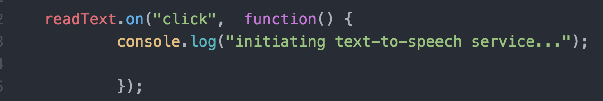
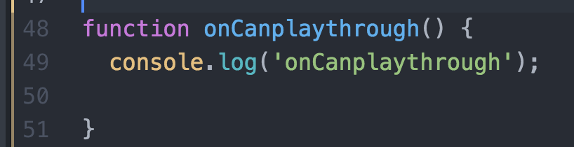
update z2c-speech
Add a new event listener to the initPage function:
Add a new function to the file

Slide 8
You’ve done it!! Congratulations
At this point, you have successfully used your second Watson service, text to speech.

Slide 9
The Plan: 30 minute Chapters with an hour or two of practice
The Story, Architecture for this app
Setting up Bluemix
Building your first Watson App (Watson Speech to Text)
Getting Watson to talk back (Watson Text to Speech)
Understanding Classifiers (Watson NLC)
Creating a custom dialog with Watson (custom Q&A, session management)
Authentication (puts C2 thru 6 together)
Alchemy News (Watson Alchemy)
Visual Recognition and Images (Watson Visual Recognition)
Watson Conversations (Watson Conversations)
Rank & Retrieve (Watson Alchemy + Rank & Retrieve)
Getting started on my first client prototype Design Thinking, Stories, Architecture, Keeping it simple
Supporting Complex environments Public Bluemix and Docker
Supporting Complex environments II Bluemix Dedicated and CloudFoundry
Creating an Inference Engine Our Inference Engine in "R"
Finding solutions Integrates C1-10, 13-15)
BlueMix, Watson and Mobile (TBD)
September-October
4Q

Slide 10
Chapter 5: Understanding Classifiers
Learning Bluemix & Cognitive
Bob Dill, IBM Distinguished Engineer, CTO Global Technical Sales

